Slide 1

B.Tech Project Evaluation-2, VIIIth Sem Project Title----
Presented by :-
Shivam Tyagi, 2018012392
Saubhagya Sharma, 2018013604
Shubham Priyadershi,2018016355
Ms.Khushi, 2018005238
Under the Supervision of:-
( Tejaswi Khanna)
Sharda University, Gr. Noida
DEPARTMENT OF COMPUTER SCIENCE & ENGINEERING
SCHOOL OF ENGINEERING AND TECHNOLOGY
May, 2022
1

Slide 2

Approval from guide for the evaluation

Slide 3
Contents of the Presentation:
Approval from guide
Workload distribution
Project Planning
Introduction
Project Overview
Results
Proof of paper Communicated

Slide 4
Workload distribution of the team 1.Saubhagya Sharma:InceptionResNetV2,Class weights, Performance Metrics 2.Shivam Tyagi: VGG 16,Sklearn ,Confusion Matrix,Seaborn 3.Ms.Khushi: MobileNetV2,Image Augmentation,Shutil 4.Shubham Priyadershi : Simple CNN, Dataframes

Slide 5
Project Planning
We started our experimental research work by reading research papers of several
techniques used in brain tumor detection, after reading many of them we decided to
come up with performance analysis of different Transfer Learning models with Simple
CNN as well.
The steps we performed are as follows:
1.First we have imported all the library files and connected with our google drive.
2.We created separate functions for plot_categories, plot_metrics and plot_cm.
3.Then we performed the Data Augmentation part.
4.Then we used class weights to give all the classes equal importance on gradient updates.
5.Then we used our simple CNN Model and ran it to some epochs to get validation_results and validation_predictions.
6.Then we used Inception ResnetV2 Model and ran it to some epochs to get validation_results and validation_predictions.
7.Then we used simple VGG16 Model and ran it to some epochs to get validation_results and validation_predictions.
8.Then we used simple MobileNetV2 and ran it to some epochs to get validation_results and validation_predictions.
9.After evaluating the data from all the models above we created a table specifying all the metrics and concluding which model performed well for the particular data set(number of epochs ran are same for all model).

Slide 6
Introduction to the Project:
Image augmentation is a method of changing the present statistics to create few greater statistics for the version schooling system. In different words, it's far the system of artificially increasing the to be had dataset for schooling a deep learning model.
Image classification is the way of categorizing and labeling set of pixels or vectors inside an photo primarily based totally on precise rules. The categorization regulation may be devised the use of one or extra spectral or textural characteristics. Two standard techniques of category are 'supervised' and 'unsupervised’.
The learning (training) part and the classification (testing) section of supervised classification are two separate machine learning challenges. The training data was made up of a predetermined number of training samples. Each pattern is a couple inclusive of the function vectors and a label. In the training section, the supervised classification set of rules analyzes the categorised training statistics and produces classification rules. In the testing section, the formerly unseen new test statistics are categorized into classes (labels) primarily based totally at the generated classification rules. The categorized labels are then in comparison with the labeled test statistics to validate the overall performance of the supervised classification.
It is a famous technique in deep mastering wherein pre-educated models are used because the place to begin on laptop imaginative and prescient and natural language processing tasks given the good sized compute and time sources required to expand neural network models on those troubles and from the massive jumps in ability that they offer on associated troubles.

Slide 7
Project Overview:
Brain tumor classification is a very important and the most prominent step for assessing life-threatening abnormal tissues and providing an efficient treatment in patient recovery. To identify pathological conditions in the brain, there exist various medical imaging technologies. Magnetic Resonance Imaging (MRI) is extensively used in medical imaging due to its excellent image quality and independence from ionizing radiations. The significance of deep learning, a subset of artificial intelligence in the area of medical diagnosis applications, has macadamized the path in rapid developments for brain tumor detection from MRI to higher prediction rate. For brain tumor analysis and classification, the convolution neural network (CNN) is the most extensive and widely used deep learning algorithm. Here,We present a comparative performance analysis of Simple CNN and transfer learning-based CNN-pretrained VGG-16, InceptionResNetV2, and MobileNetV2 models for automatic prediction of tumor cells in the brain. Pretrained models are demonstrated on the MRI brain tumor images dataset consisting of 253 images. As an outcome, we estimated that the pretrained model MobileNetV2 determines highly adequate results with more accuracy.

Slide 8
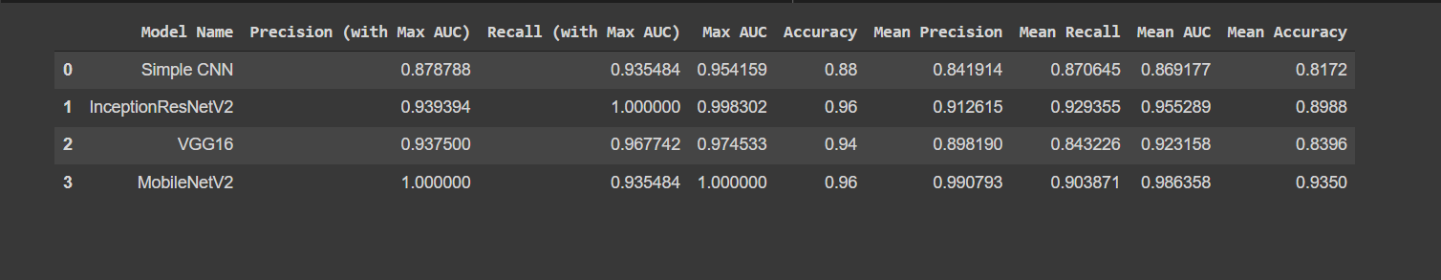
Results

Slide 9
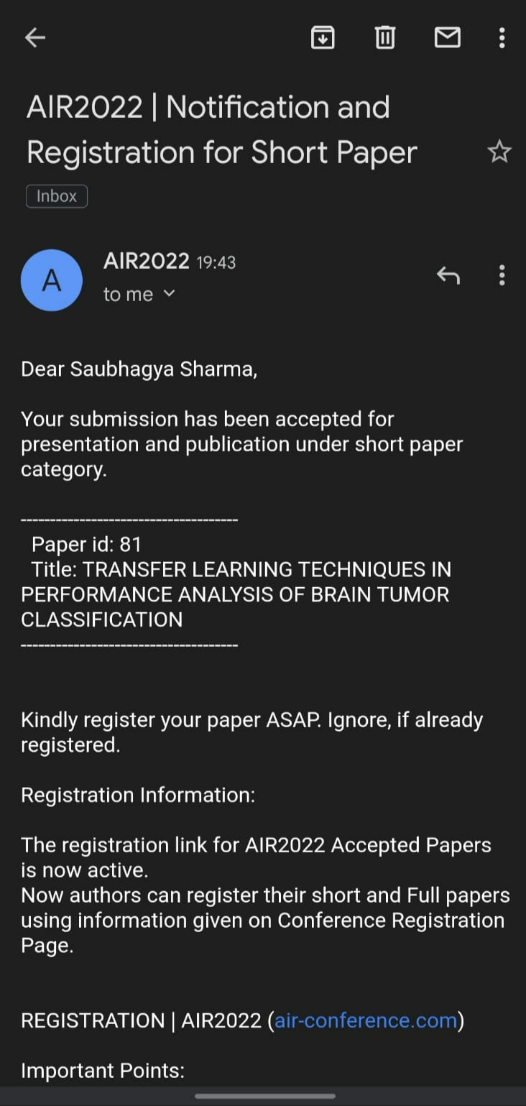
Proof of paper accepted or communicated/ Hackathon/ Patent

Slide 10
Thank You

